Slide 1
Jumpstart your job search
Resumes

Slide 2


Slide 3

What to Expect
Resume BKM overview
Workshop covering two toughest resume sections to write
Executive summary
Accomplishment statements
Get resume questions answered
Email with materials sent after the workshop
Other job search materials can be found on Blue Hire ExpoLearn pathway

Slide 4


Slide 5
The Lifecycle of Your Resume
Applicant Tracking Software/Recruiter/ Search
Hiring Manager
First Pass
Interview Team’s First Impression of YOU
May or may not apply to internal candidates
Top 1/3rd
First Glance
5-10 secs
to decision
If you made it this far, rest of the resume is reviewed in detail
Notes:
Did you know…. The average time a manager takes to screen a resume for follow up is 10 seconds?
A 5 sec first glance at the top of your resume, decides if they will scan the rest.

Slide 6
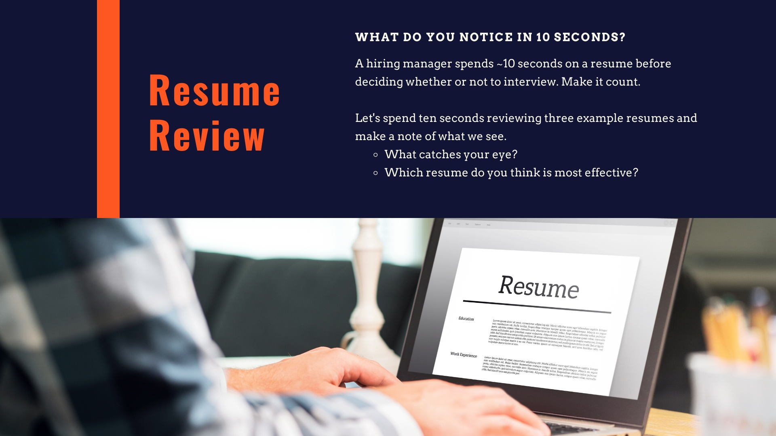

Slide 7
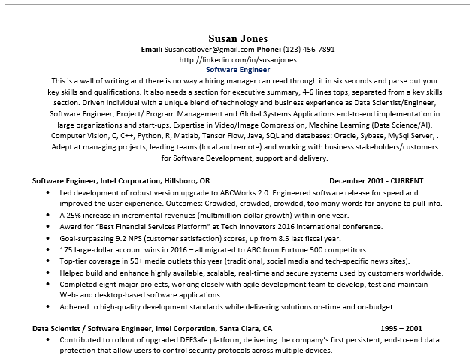

Slide 8
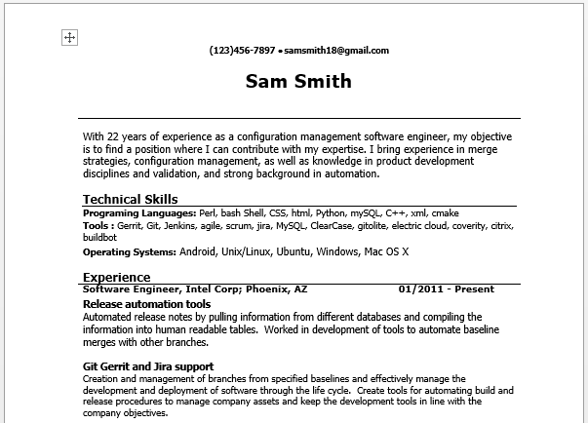

Slide 9
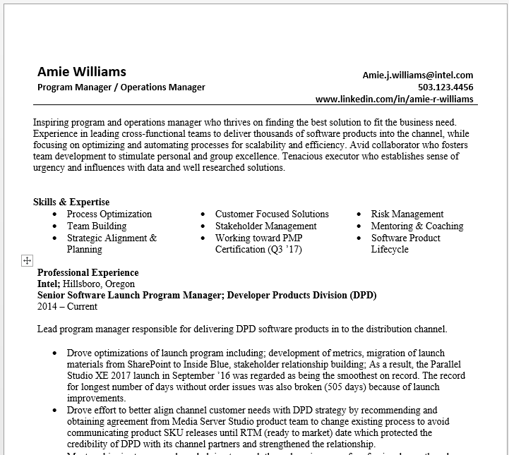

Slide 10

10 second review
Clean - visually appealing, easy to read
1 page for <5 years’ experience, 2 pages for experienced, 2+ if exec and can’t get it all in
White space is your friend & highlight strategically
A profile/summary about who you are and highlights YOUR UNIQUE VALUE
As you apply to specific reqs, weave key words from req into your summary statement where appropriate
List of Skills & Capabilities
An easy to read summary of what you are capable of – both what you can do and how you do it (relevant soft skills)
Include personal branding statements

Slide 11

It is an advertisement
Focus on relatable accomplishments
Include personal branding statements
Stick to relevant & recent info
Tailor it for each application
Read req critically
Use TagCrowd or Wordle or SkillSyncer
Call out transferrable skills
Write it for the job you want, not the job you have now

Slide 12

Notes:
Why we tailor…all cereal is not the same just the same as not all software developers are the same. Think about your target market…what are they looking for?

Slide 13

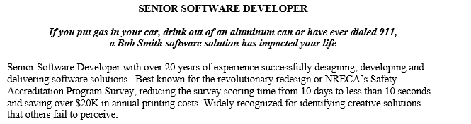
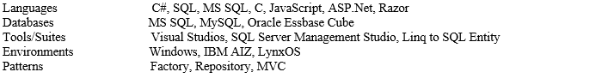
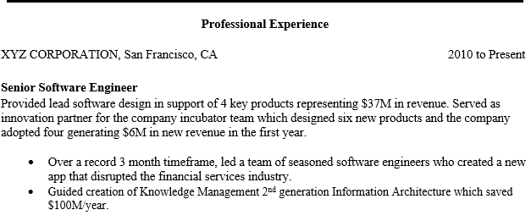
Focus on the top 1/3
Heading: Contact information is crisp, correct and complete.
• Use your professional name.
• List telephone contact information for office, cell and home.
• Provide social media public URL of your LinkedIn® profile
Summary Statement: One to three creative and descriptive sentences to encapsulate experience, expertise and skills presented in the body of the resume.
• Keep the essentials, nothing else.
• Correlate to language in posted job description.
• Use company language and key words.
Key Words
Look for key words in the job description and duplicate them in the summary statement as you
describe your abilities (if applicable).
This helps your resume pass the scan test
Employment History:
Markets your internal job experience, skills and results to your target.
• List and expand on current employer first.
• Use powerful and active verbs.
• Leverage a combination of hard and soft skills.
• Remember to quantify.
• Add only relevant previous employers and experience.
Notes:
Keep your resume checklist and make notes on what changes you want to make to your resume
Focus on the top 1/3
Go section by section highlighting what to look for – checking along with their on resume

Slide 14
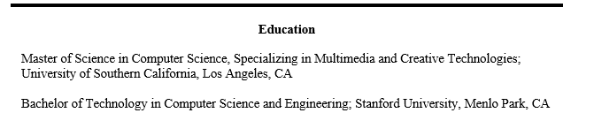

Additional Sections
Education: Lists noteworthy educational accomplishments and builds credibility.
• List name of college, location, degree and any minor degrees.
• Place experience before education if you have two or more years of experience related to your goal.
Award/ Recognitions
List awards that are relevant only.

Slide 15

ACCOMPLISHMENT STATEMENTS
Accomplishment statements set you apart from other candidates in a way that a list of tasks and responsibilities cannot.

Slide 16
Showcase your Accomplishments
ACTIVITY IS NOT ACCOMPLISHMENT
Being busy does not always mean real work. The
object of all work is production or accomplishment…
Seeming to do is not doing.
- Thomas Edison
RESULTS FOR THE BUSINESS ARE ACCOMPLISHMENTS
RESULTS FOR THE BUSINESS ARE ACCOMPLISHMENTS

Slide 17
Accomplishments
Accomplishments = the Business Results from what you did this year
Answer the “So What?”
Revenue, Cost, Yield, time savings, improvements, etc
Quantify whenever possible
Tie to team, organization or Intel objectives – its about moving the business forward
Balance – “Bragging” & Teamwork/Collaboration
PAR Formula; Problem (P) + Action (A) = Result (R)

Slide 18
Accomplishments
ACTION = “Trained employees.”
ACTION + PROBLEM + RESULTS = “Trained new employees resulting in increased customer satisfaction.”
ACTION + PROBLEM + QUANTIFIED RESULTS = “Trained more than 15 new employees over a 12 month period resulting in increased customer satisfaction.”
EVEN MORE IMPACT BY ADDING A POWER VERB + LEADING WITH THE RESULT=
“Increased customer satisfaction by 25% through effectively training 15+ new employees over 1 year.”
Notes:
Similar to writing an accomplishment statement for you resume. Basically, adding context to your action.

Slide 19
Accomplishments
Negotiated a $15M savings for Intel across 3 vendor engagements including development of a new vendor
Delivered power management driver for Whisky Lake on A1 stepping Si, resulting in a zero-defect B0 platform launch availability for power management
Implemented real time monitor and response system resulting in 99.9997% server uptime for D1C and reducing technician cost by 6 person-months of contract
Created automated validation system that expanded test coverage to 90% and met PRQ deadlines
Completed vendor engagements on 3 major contracts
Delivered Whisky Lake Power Management driver
Maintained D1C Server Room Infrastructure
Launched First Optane SSD
Did Stuff
Delivered Value

Slide 20

EXECUTIVE SUMMARY
4-5 sentence summary highlighting your unique value through branding statements which describe who you are and what you do well.

Slide 21
Use Power Adjectives & Power Verbs
Power Adjectives – Use to describe yourself and your brand
Example:
Versatile, hands-on technical leader…
Award-winning marcom professional…
High-energy leader in data warehousing and business intelligence…
Power Verbs – Show that you took action
Example:
Energized web presence for Saas startup…
Produced media kit that demonstrated key marketing analytics…
Designed the largest data warehouse in company history…

Slide 22
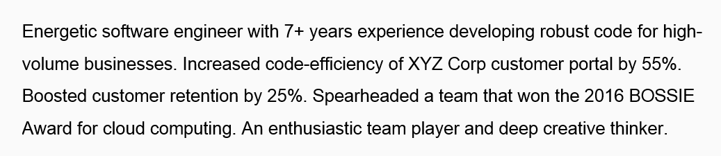
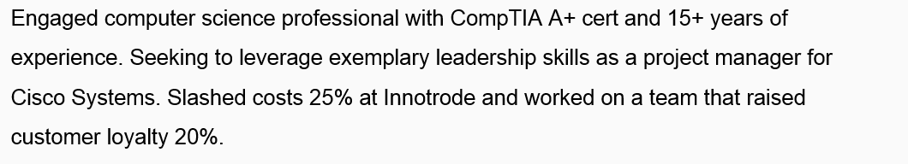
Example Executive Summaries

Slide 23


Slide 24
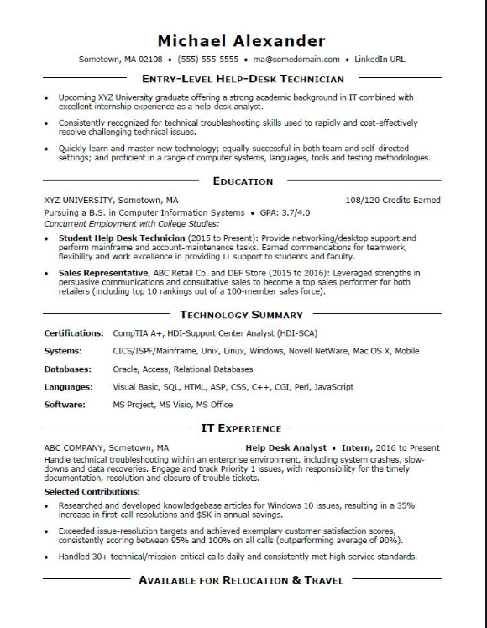
Example 1: <5 years experience example
1 – 1 ½ pages
May need to rely on education & non-paid experience

Slide 25
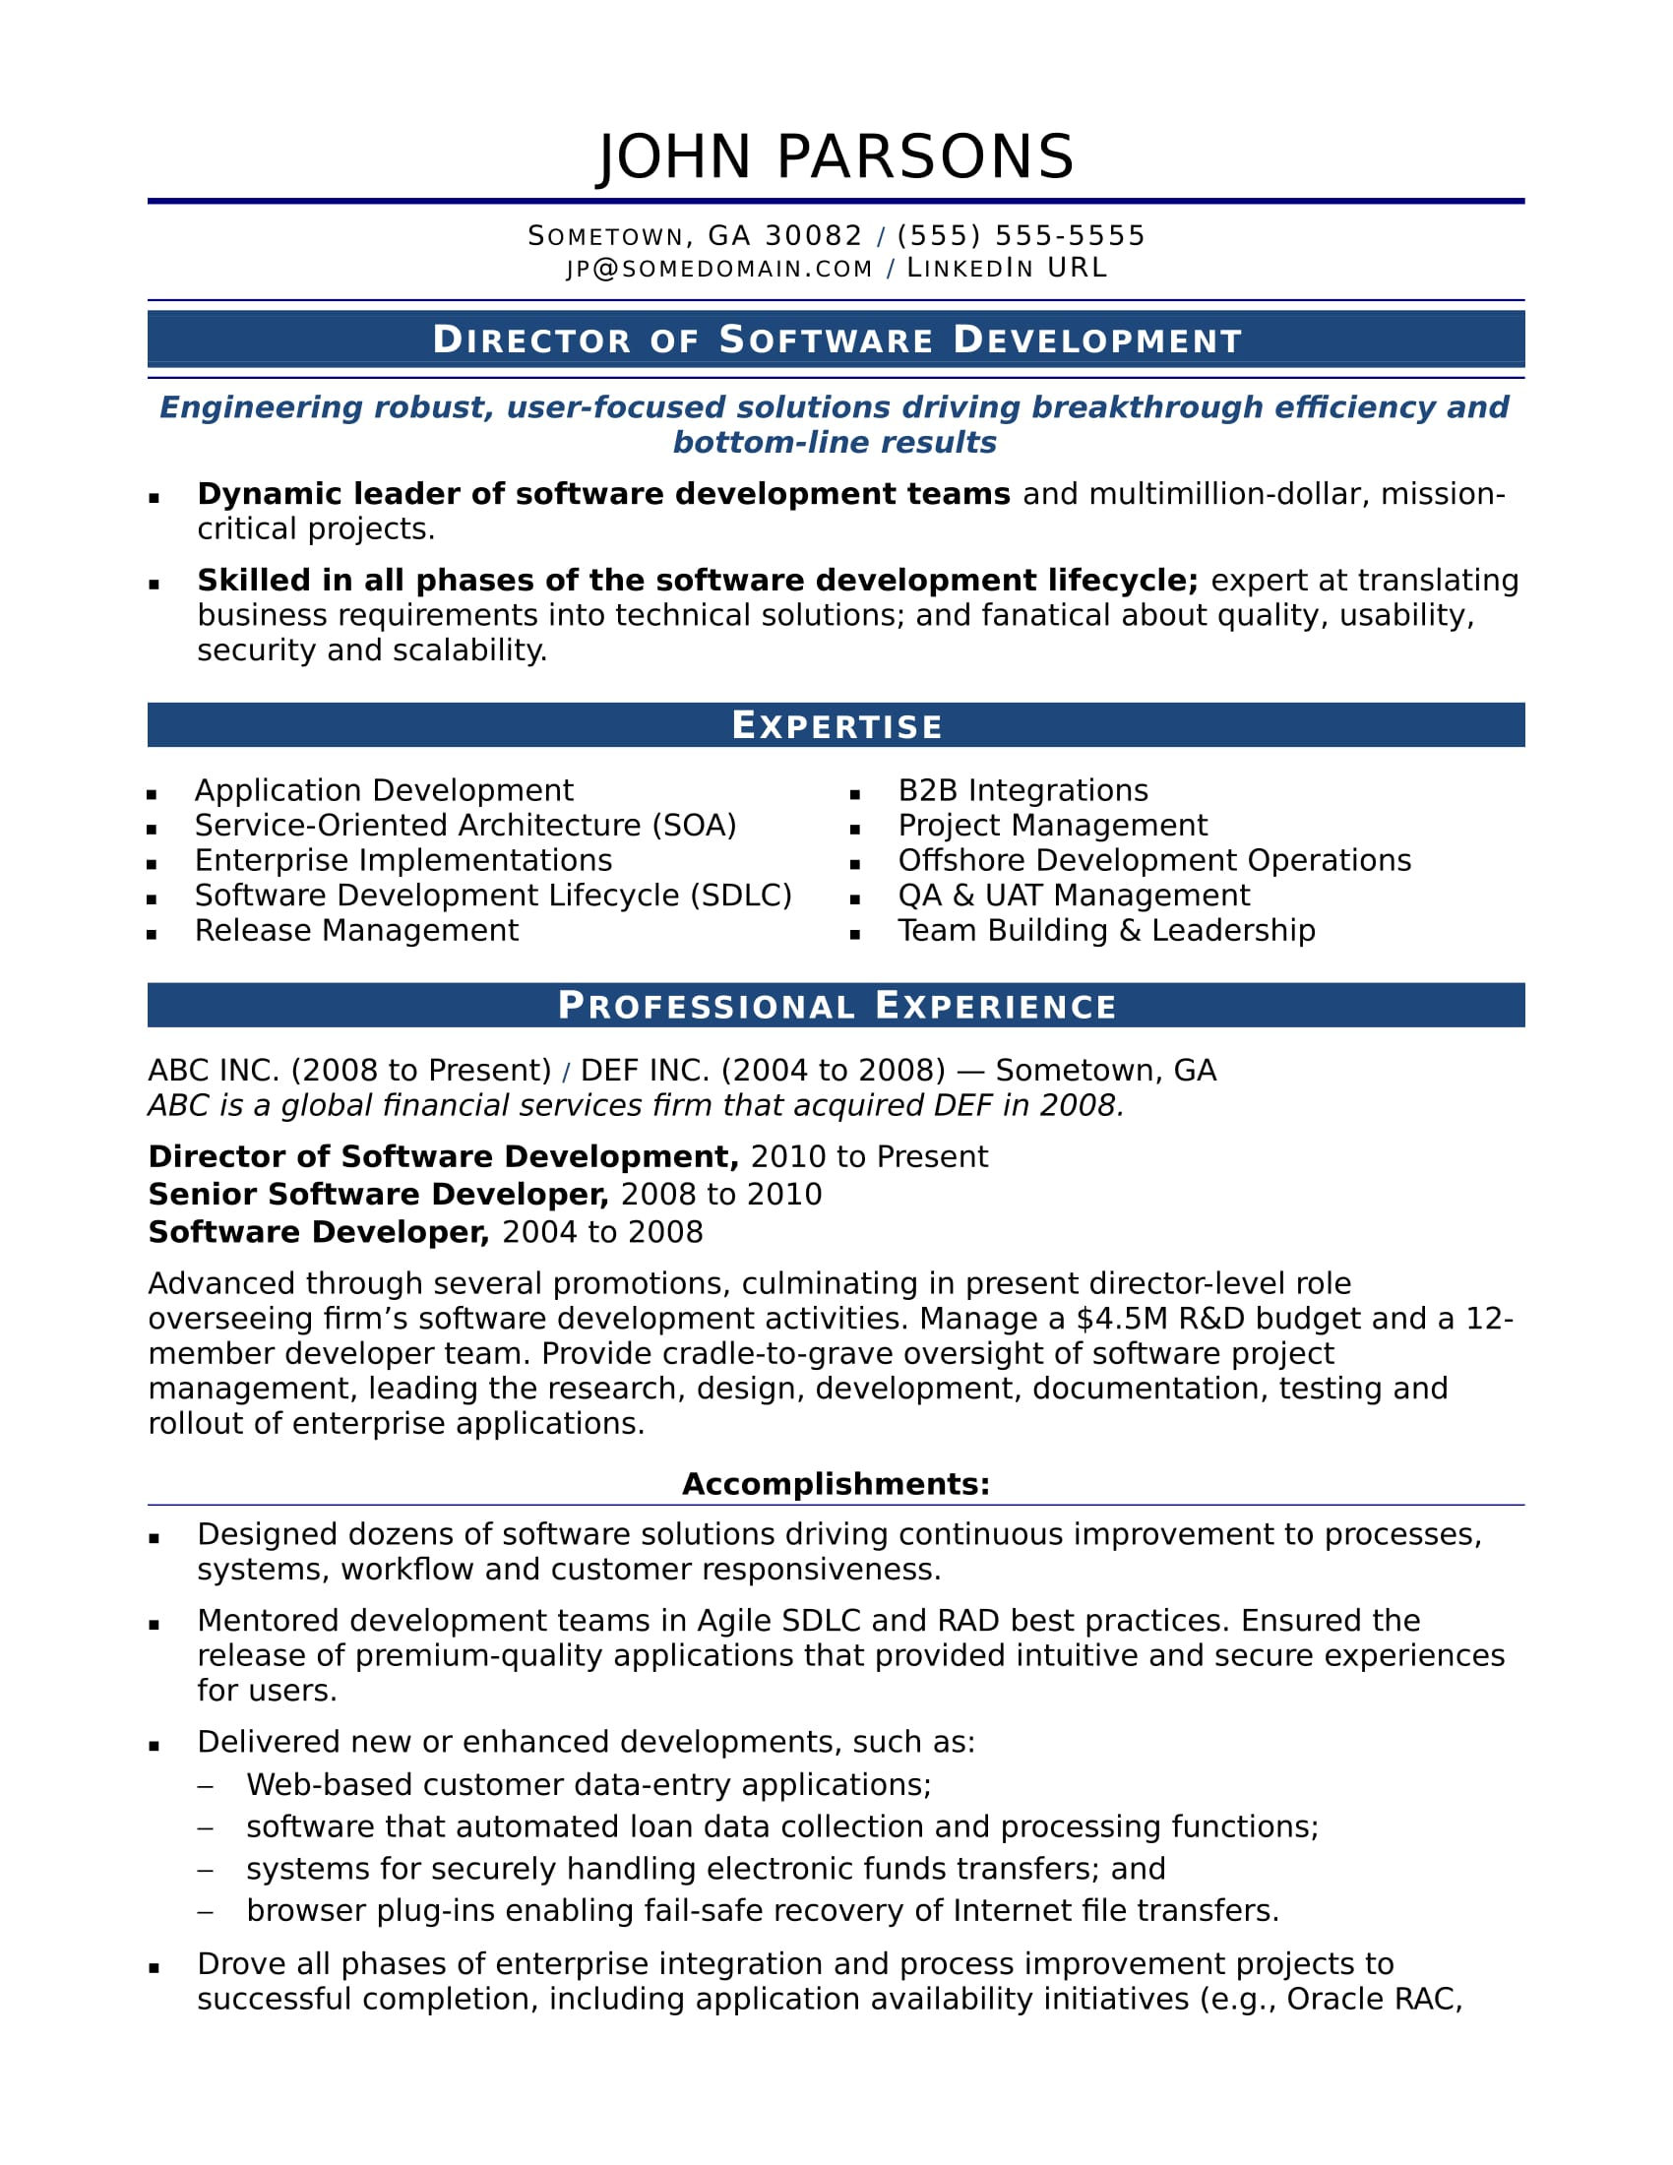
Example 2: experienced professional example
2 pages
Additional pages for publications & patents

Slide 26
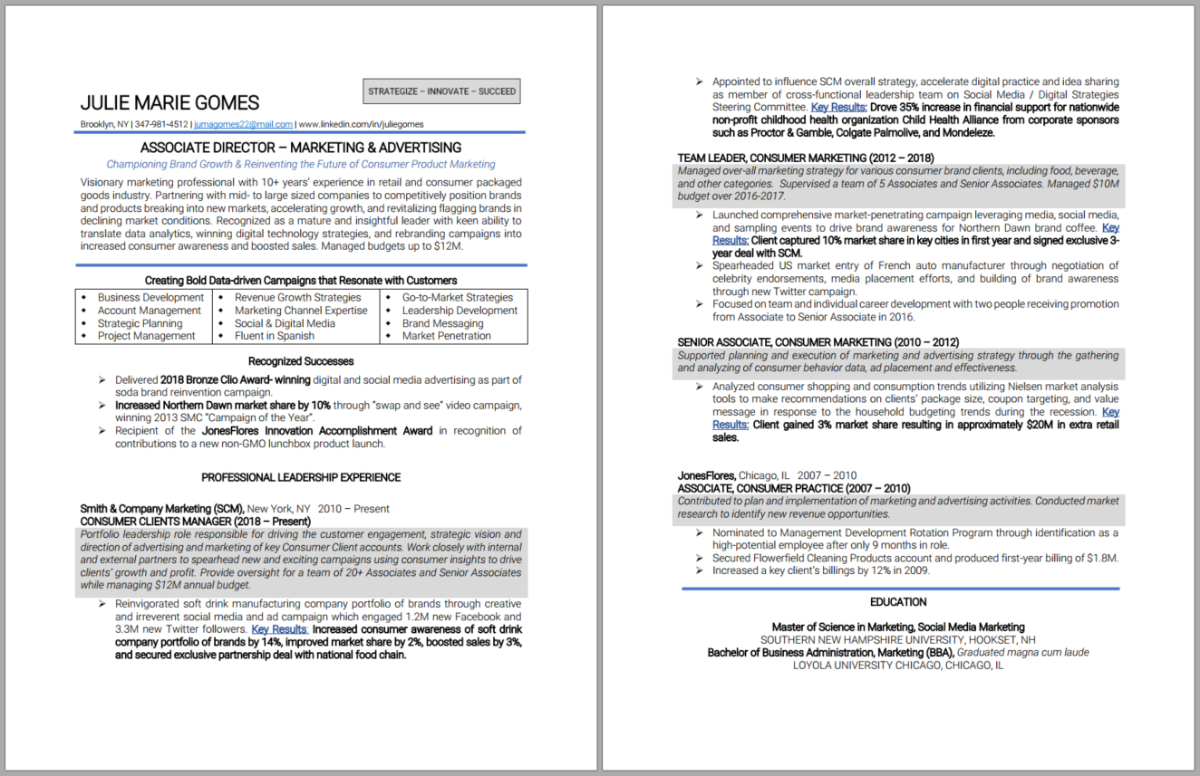
Example 3: Executive
2+ pages
Additional pages for publications & patents

Slide 27


